Slide 1
GENERALIZED HOUGH TRANSFORM

Slide 2
Recap on classical Hough Transform
In detecting lines
  The parameters ρ and θ were found out relative to the origin (0,0)
In detecting circles
  The radius and center were found out
In both the cases we have knowledge of the shape
We aim to find out its location and orientation in the image
The idea can be extended to shapes like ellipses, parabolas, etc.

Slide 3
Parameters for analytic curves
Analytic Form | Parameters | Equation
Line | ρ, θ | xcosθ+ysinθ=ρ
Circle | x₀, y₀, ρ | (x-x_{o})²+(y-y₀)²=r²
Parabola | x₀, y₀, ρ, θ | (y-y₀)²=4ρ(x-x_{o})
Ellipse | x₀, y₀, a, b, θ | (x-x_{o})²/a²+(y-y₀)²/b²=1

Slide 4
Generalized Hough Transform
The Generalized Hough transform can be used to detect arbitrary shapes
Complete specification of the exact shape of the target object is required
The Shape is specified in the form of the R-Table
Information that can be extracted are
  Location
  Size
  Orientation
  Number of occurrences of that particular shape

Slide 5
Creating the R-table for Generalized Hough Transform
Algorithm to create the R-Table
  Choose a reference point
  Draw a vector from the reference point to an edge point on the boundary
  Store the information of the vector against the gradient angle in the R-Table
  There may be more than one entry in the R-Table corresponding to a gradient value

Slide 6
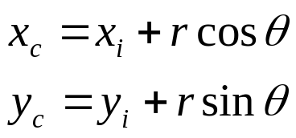
6.3 Generalized Hough Transform - Algorithm
Form an Accumulator array to hold the candidate locations of the reference point
For each point on the edge
  Compute the gradient direction and determine the row of the R-Table it corresponds to
  For each entry on the row calculate the candidate location of the reference point
  Increase the Accumulator value for that point
The reference point location is given by the highest value in the accumulator array

Slide 7
6.4 Generalized Hough Transform – Size and Orientation
The size and orientation of the shape can be found out by simply manipulating the R-Table
For scaling by factor S multiply the R-Table vectors by S
For rotation by angle θ, rotate the vectors in the R-Table by angle θ

Slide 8
6.5 Generalized Hough Transform – Advantages and disadvantages
Advantages
  A method for object recognition
  Robust to partial deformation in shape
  Tolerant to noise
  Can detect multiple occurrences of a shape in the same pass
Disadvantages
  Lot of memory and computation is required

Slide 9
7.1 Improvisation of the Hough transform for detecting straight line segments
Hough Transform lacks the ability to detect the end points of lines – localized information is lost during HT
Peak points in the accumulator can be difficult to locate in presence of noisy or parallel edges
Efficiency of the algorithm decreases if image becomes too large
New approach is proposed to reduce these problems

Slide 10
7.2 Spatial decomposition
This technique preserves the localized information
Divide the image recursively into quad-trees, each quad-tree representing a part of the image i.e. a sub-image
The leaf nodes will be voted for feature points which are in the sub-image represented by the leaf node

Slide 11
7.2 Spatial Decomposition of Hough Transform
Parameter space is defined from a global origin rather than a local one
Each node contains information about the sub-nodes as well as the number of feature points in the sub-image represented by the node
Pruning of sub-trees is done if the number of the feature points falls below a threshold
An accumulator is assigned for each leaf node

Slide 12
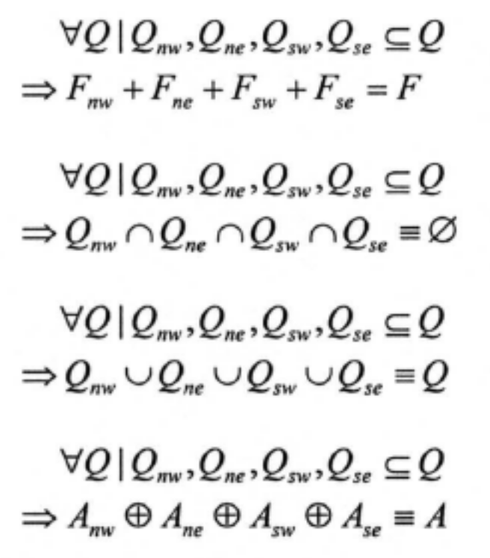
7.3 Some relations involved in spatial decomposition
Consider the following
  Q – any non-leaf node
  F – feature points in the sub-image represented by this node
  A – parameter space of the sub-image
The following relations hold true

Slide 13
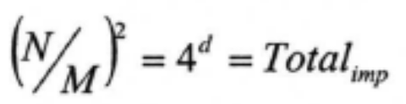

7.4 Number of accumulator arrays required
Consider the following case
  Size of image = N X N
  Size of leaf node = M X M
  Depth of tree = d (root node = 0)
Number of accumulator arrays for only leaf nodes =
Number of accumulator arrays for all nodes =

Slide 14
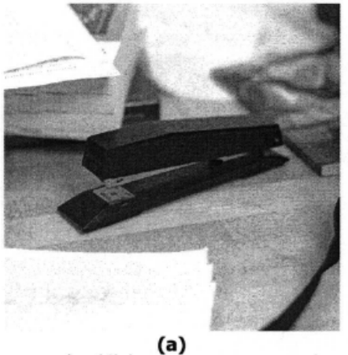
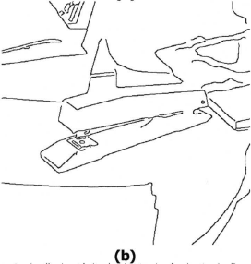
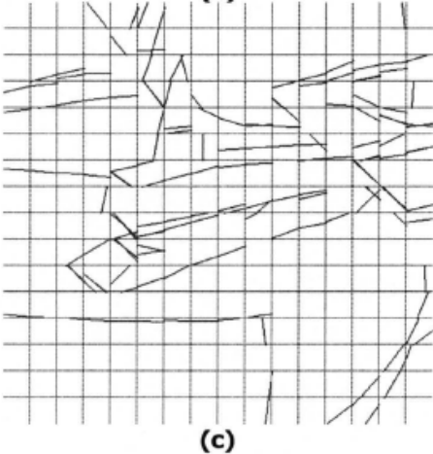



7.5 Example

Slide 15
References
Generalizing The Hough Transform to Detect Arbitrary Shapes – D H Ballard – 1981
Spatial Decomposition of The Hough Transform – Heather and Yang – IEEE computer Society – May 2005
Hypermedia Image Processing Reference 2 – http://homepages.inf.ed.ac.uk/rbf/HIPR2/hipr_top.htm
Machine Vision – Ramesh Jain, Rangachar Kasturi, Brian G Schunck, McGraw-Hill, 1995
Machine Vision - Wesley E. Snyder, Hairong Qi, Cambridge University Press, 2004

Slide 16
sources
Presentation by Sumit Tandon
Department of Electrical Engineering
University of Texas at Arlington
Course # EE6358 Computer Vision

